Slide 1
DS&AI Project: Situation Calculus
Marcello Bonsangue
LIACS – Leiden University
m.m.bonsangue@liacs.leidenuniv.nl
Reusing slides from M. Shanmugasundaram

Slide 2
Essentials of Situation Calculus
Situation Calculus was introduced by John McCarthy in 1969.
It describes dynamic domains in FOL using:
- Situations (denote world states; include world history)
- Actions (named, parameterized functions)
- Axioms (to specify actions and domain knowledge)
Planning (or: reasoning with actions) in the situation calculus is done through theorem proving:

Slide 3
Situation Calculus - Overview
Situation Calculus
Actions
Situations
Result
Effect & Frame
Planning
Plan

Slide 4
Situations
Structured
Semi-Structured
Unstructured
A situation corresponds to a world (state).
Situations are denoted through FOL terms: e.g. S, S'
Actions transform situations, i.e. the application of an action in a given situation S yields a situation S’.
Situations thus also refer to possible world histories.
For example, the expression
Refers to the action sequence:
Yielding a new situation S when applied to S₀.

Slide 5
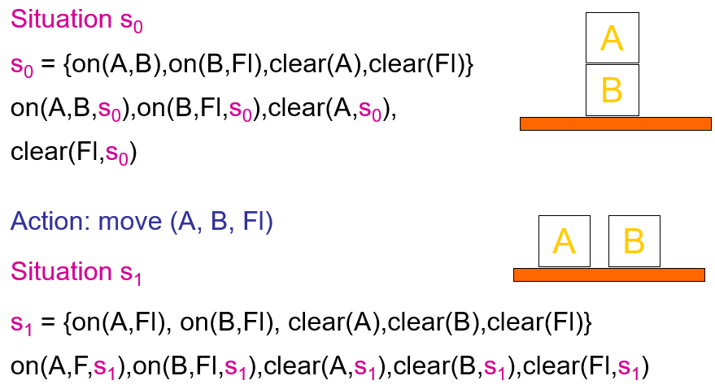
Situations - Example

Slide 6
Actions
Actions are written as functions with their name and a parameter list. They can also be referred to by variables (→ reification).
Actions transform situations.
The performance of an action in a situation is denoted through the Result or do function.
The performance (do) of an action a in a situation s yields a new situation s'.

Slide 7
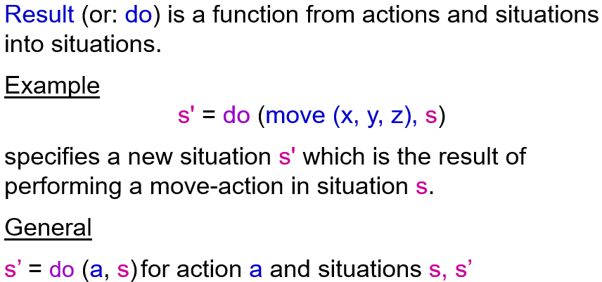
Result- or do-Function

Slide 8
do-Function - Example
situation s = {on(A,B), on(B,Fl), clear(C)}
action a = move (A,B,C)
apply action a in situation s
- do (move (A,B,C) , s) = s’
- s' = {on(A,C), on(B,Fl), clear (B)}
Instead of specifying the situation s' this way, we add situations into the basic formulas (certain basic formulas - and terms).

Slide 9
Fluents
Predicates and functions, whose values change due to actions, are called fluents.
Predicates, whose truth values can change, are called relational fluents.
Functions, whose denotations can vary, are called functional fluents.
Actions in a domain are specified by providing action precondition axioms, effect axioms and frame axioms.
example: is_holding(robot, p, s) or on(x,y,s)
example: loc(robot, s) or under(x,s)

Slide 10
Situations in Formulas
Integrating situations into the formulas above yields:
situation s: on(A,B,s), on(B,Fl,s), clear(C,s)
action a: move (A,B,C)
apply action a in situation s
situation s’: on(A,C,s'), on(B,Fl,s'), clear(B,s’)
Note: Persistent predicate expressions like Block(A), Block(B), ... remain without s.
do (a, s)
do (move (A,B,C), s) = s'

Slide 11
The Calculus of Situation Calculus

Slide 12
Axioms for Actions
Actions are specified by providing a certain set of domain-dependent axioms. These are:
Action Precondition Axioms: describe under what conditions an action can occur use additional function Poss.
Effect Axioms: describe what is changed due to an action
Frame Axioms: describe what remains unchanged, when an action takes place

Slide 13
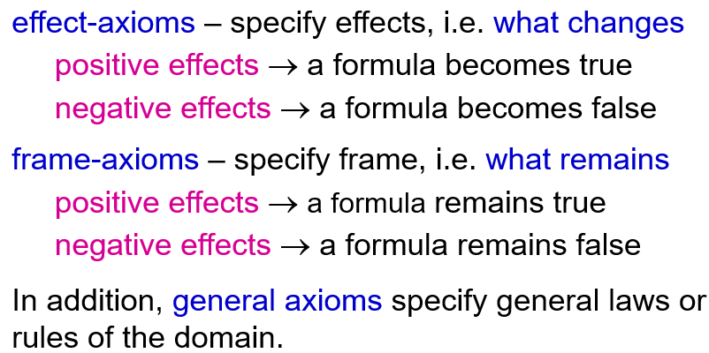
Action Description - Axioms
Axioms specify what changes and what remains. Consider every combination of action and fluent.

Slide 14
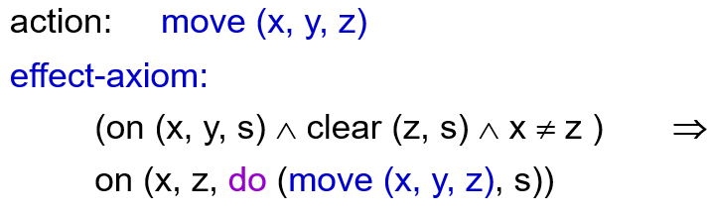
Effect Axiom - Move-Example
Explanation:
If the left side (condition) of the axiom holds, then the action can be performed, and the right side (consequence) follows.
The consequence states what is true in the resulting situation, here: on(x,z,s)

Slide 15
Effect Axioms - move-example
Positive Effect
on (x, y, s) ∧ clear (x, s) ∧ clear (z, s) ∧ y ≠ z ⇒ on (x, z, do (move (x, y, z), s))
Negative Effect
on (x, y, s) ∧ clear (x, s) ∧ clear (z, s) ∧ y ≠ z ⇒ ¬on (x, y, do (move (x, y, z), s))
If x is on y, both x and z are clear, and z is not the block onto which x is moved, then a result of the move-action is that x is on z.
If x is on y, both x and z are clear, and z is not the block onto which x is moved, then a result of the move-action is that x is not anymore on y.

Slide 16
The Frame-Problem
There can be a large number of frame axioms necessary to describe a domain.
This complicates the task of axiomatising a domain and makes planning or reasoning in situation calculus (theorem proving) extremely inefficient.
This is the famous Frame Problem.

Slide 17
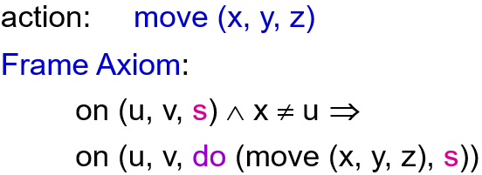
Frame Axiom - move-example
Explanation:
A Frame Axiom states, what remains true or unaffected, when an action is performed.
In the example here: a block u, which is not the one moved, remains where it is, i.e. on (u, v) is still valid after the action.

Slide 18
Frame Axioms - move-example
Positive Frame Axiom:
on (u, v, s) ∧ x ≠ u ⇒ on (u, v, do (move (x, y, z), s))
Negative Frame Axiom:
¬on (u, v, s) ∧ (x ≠ u ∨ y ≠ v) ⇒ ¬on (u, v, do (move (x, y, z), s))
If a block u is on another block v, and u is not the block being moved, then it stays on v.
If a block u is not on another block v, and u is not moved, or nothing is put on v, then u will still not be on v after the move.

Slide 19
Successor-State Axioms
Collect all the effect axioms which affect a given fluent. Assume that they specify all of the ways that the value of the fluent can change. Then apply a syntactic transformation to the effect axioms to obtain a successor state axiom for the fluent.
Successor-State-Axioms:
combine frame and effect axioms;
specified for each fluent - action pair

Slide 20
Example
If a is possible in s, and there is a robot r, such that a is the action that the robot repairs x, then x is not broken after the "robot repairs x action" was done in s.

Slide 21
Successor-State Axioms
General Structure:
Predicate expression is true in follow state ⇔ the action made it true
Or: It was true and the action did not make it false.

Slide 22
How to Derive Successor-State Axioms?
Effect Axioms Schema:
General Successor State Axiom:
a action; s situation; F fluent; γ condition for F to become true (false) for a in s.

Slide 23
Situation Calculus Axioms - so far
Effect axioms describe how an action changes a situation, when the action is performed.
Frame axioms describe, what remains unchanged between situations.
Successor-state axioms combine effect and frame axioms.
Add domain knowledge!

Slide 24
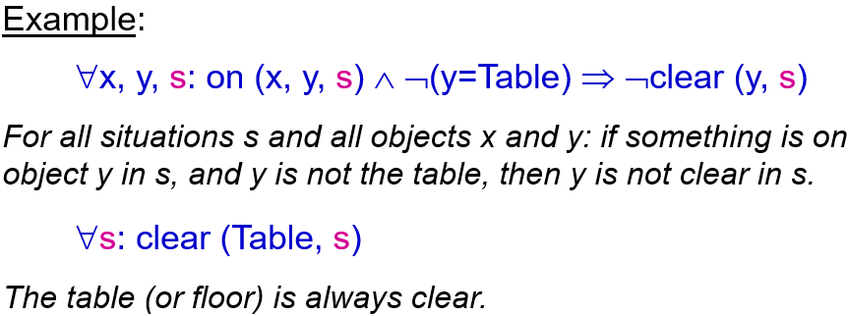
Domain knowledge
General axioms:
Describe formulas, which are true in all situations.

Slide 25
Frame-Problem
Frame-Problem:
specify everything which remains stable
Leads to too many conditions which would have to be explicitly stated for any state transformation. Computationally very expensive.
Approach: successor-state axioms

Slide 26
Qualification-Problem
Qualification-Problem:
Approach: non-monotonic reasoning with standard preconditions and effects as defaults.
Specify everything which is precondition to an action.
Difficult to include every precondition, which could prevent (if not fulfilled) the action to be performed.

Slide 27
Ramification-Problem
Ramification-Problem:
Conflict between change and frame for derived formulas
Some axioms state conclusions about fluents indirectly affected by actions. This can contradict frame-axioms.
Approach: better specification
Example: An agent grabs an object and holds it. When the agent moves, the object moves too (domain model), though this is not explicitly stated (not an effect axiom). Normally, objects are supposed to stay, where they are (frame-axiom).
Frame: every object stays where it is unless it is moved.
Domain: if an object is attached to another object and one of the objects moves, the other object moves too.

Slide 28
Planning

Slide 29
Situation Calculus and Planning
Planning starts with a specified start situation and the specification of a goal situation.
Planning comprises of finding a proof which infers the goal situation from the start situation using successor-state and other axioms.
A Plan can be read from the proof: it is the sequence of actions causing the sequence of transformations of situations from the initial situation to the final situation.
For example, prove S' = at (A, L) from S0 = at (A, S0)

Slide 30
GOLOG
Hector J. Levesque, Raymond Reiter, Yves Lesperance, Fangzhen Lin and Richard Scherl, Golog: A logic programming language for dynamic domains, Journal of Logic Programming, 31, 59-84, (1997).
M. Shanmugasundaram, Presentation in 74.757, 2004.

Slide 31

Golog
Golog is a kind of logic programming language for reasoning with actions, based on situation calculus.
It allows in addition to express and reason with more complex action structures, like:
Golog → “alGOL in LOGic”

Slide 32
Golog - Basics
Complex action expressions are defined using additional extralogical symbols (e.g., while, if, etc.), which act as abbreviations for logical expressions in the language of the situation calculus.
These extralogical expressions are like macros, which expand into genuine formulas of the situation calculus.
The abbreviation Do(δ, s, s’) is the most basic abbreviation used in the Golog language, where δ is a complex action expression.
Do(δ, s, s’) means that executing δ in situation s has s’ as a legal terminating situation.
Complex actions may be nondeterministic, i.e. they may have several different executions terminating in different situations.

Slide 33

Golog - Definitions 1
Do is defined inductively for the structure of its first argument:
Primitive actions:
Test actions:
Sequence:

Slide 34


Golog - Definitions 2
Nondeterministic choice of two actions:
Nondeterministic choice of action arguments:
Nondeterministic iteration:

Slide 35

Golog - Conditionals
Conditionals and while loops are defined in terms of the above constructs as follows:

Slide 36
Golog - Conditionals
Procedures are hard to define in situation calculus semantics using macro expansion, because there is no straightforward way to expand a procedure body, when that body includes a recursive call to itself.
Use an auxiliary macro definition for any predicate symbol P of arity n+2, taking a pair of situation arguments:

Slide 37

Golog - Procedures
Semantics of procedures: A Golog program follows the block-structured programming style. A program of the form:
Will then be evaluated as:

Slide 38
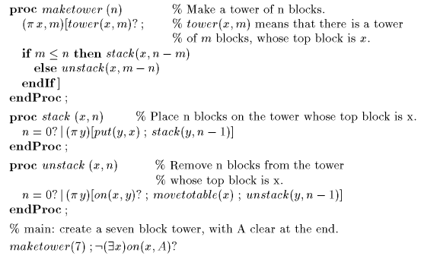
Golog - Blocks World Example
A blocks world program to make a seven block tower with block A clear in the final situation.

Slide 39

Programming in / Planning with Golog
Golog programs are "executed" using theorem proving.
Program execution means, given a program δ and an initial situation s₀, find a terminating situation s for δ, if one exists.
To do so, we prove the termination of δ as:
And then extract from the proof a binding for the terminating situation.

Slide 40
Elevator Controller in GOLOG

Slide 41

GOLOG - Elevator Controller

Slide 42
GOLOG - Elevator Controller
The next floor (to be served) is the nearest floor to the floor, where the elevators is now, in s.

Slide 43
GOLOG-Procedures for Elevator

Slide 44
GOLOG - Running the Elevator
Intial State:
"Running the Elevator Program“:
Find situation s:
and collect matching action sequence:

Slide 45
Elevator Controller - Initial and Final Situation
The initial situation axiom specifies that, initially buttons 3 and 5 are on, and moreover no other buttons are on. Thus, we have complete information initially about which call buttons are on.
A successful proof for the elevator program, for example, may return the following binding for s:

Slide 46
Elevator Controller - The Plan
This example shows that Golog is a logic programming language in the following sense:
Its interpreter is a general purpose theorem prover.
Like Prolog, Golog programs are executed to obtain bindings for the existentially quantified variables of the theorem.

Slide 47
Golog - Planning as Theorem Proving
Running a program is a theorem proving task, which establishes the following entailment:
The meaning of this entailment:
Do is a macro and not a predicate, and the expression stands for a much longer situation calculus sentence.
We seek a proof of this macro-expanded sentence from axioms, which characterise the fluents and actions of the domain.
The execution trace represented by this binding is passed as solution to the elevator’s execution module, which uses it for controlling the elevator in the physical world.

Slide 48
Review
Golog is a logic programming and planning language for implementing applications in dynamic domains, like robotics, process control, intelligent software agents, discrete event simulation etc.
It is based on a formal theory of actions specified in an extended version of the situation calculus.
Planning or programming in Golog is based on Theorem Proving and methods adapted from Program Verification.

Slide 49
References
Hector J. Levesque, Raymond Reiter, Yves Lesperance, Fangzhen Lin and Richard Scherl, Golog: A logic programming language for dynamic domains, Journal of Logic Programming, 31, 59-84, (1997).

